Slide 1
Updates on GNU/Hurd progress:
rump drivers, 64bit, SMP,
software bootstrapping, ...
Samuel Thibault
2026 February 1rd

Slide 2
The Hurd is all about freedom #0
“The freedom to run the program, for any purpose”
I.e.:
Freedom from sysadmin!
  WTH is fdisk/mke2fs/... hidden in /sbin?
  I should be able to just work with my disk/network access
Freedom to innovate
  Experimental filesystem, personal work-flow, new kind of process combination,…
  Give a PCI card function to a process
Freedom from misbehaving programs and drivers

Slide 3
It's all about freedom #0
From: xxx <xxx@yyy.fr>
Subject: Network expertise
Date: Thu, 31 Jan 2013 12:37:34 +0100
[…] Would it be possible to route to my VPN the traffic of only one application?
Actually, also well-known classical issue of full-VPN: traffic of the VPN itself shouldn't go through the VPN!
And yet, here root capabilities!!
Spoiler: Yes, GNU/Hurd can already do it. Without even asking root.

Slide 4
It's all about freedom #0
Extensibility for the user
Mount one's own files
  Access archives content
  Access remote files
  Experiment with filesystems
Access one's own network
  Access remote networks / VPN
  Access virtual machine network
Redirect one's sound
  Through network
  Sound effects
  Recording
…
and Flexible hardware support

Slide 5
Outline
Monolithic/Gvfs/FUSE/micro-kernel layering
Hurd layering
Hurd nifty features
Present and future

Slide 6
Outline
Hurd architecture Overview
Console support
Network support
Nice translators
Real-life nice story
Software support
Hardware support
Releases & future

Slide 7
Outline
note: Start downloading glibc, hurd, gnumach source code now
Hurd architecture Overview
Flexibility, flexibility, flexibility!
3 Hurdish paths
  ext2fs example
  pflocal example
  gnumach example
Present & future

Slide 8
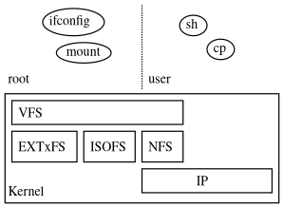
Traditional monolithic layering

Slide 9
Traditional monolithic layering
User mounts through “users” option
  Need to ask root
    and frowned upon
  Only kernel-provided filesystems
User network through tap
  Need to ask root
  No personal firewall tuning support

Slide 10
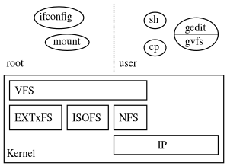
gvfs layering

Slide 11
gvfs layering
Supports a lot of nice features
  Transparent ftp, webdav, smb, ...
Only works for gnome applications
  Not even in gnome-terminal shells
  Not easily extensible
i.e., does not compose well.

Slide 12
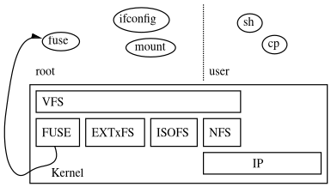
FUSE layering

Slide 13
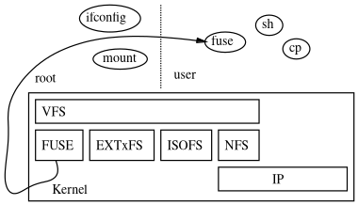
FUSE layering, user

Slide 14
FUSE layering
Provides a lot of nice features, but
Does not combine well by default
  cd ~/.avfs/#ftp:ftp.gnu.org/.../coreutils-6.9.tar.bz2#
  does not work
Does not optimize well by default
  fuseiso9660 ~/.avfs/#ftp:ftp.gnu.org/.../foo.iso ~/mnt
  downloads it all!
Does not provide all root features by default
  How to deal with partitioned disk image?
  e2fsck what?
→ Users are still second-class citizens

Slide 15
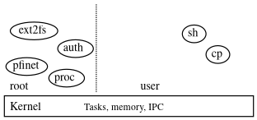
Micro-kernel layering

Slide 16
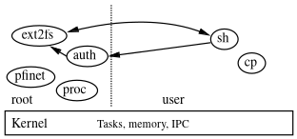
Micro-kernel layering

Slide 17
Micro-kernel layering
Server crash? Not a problem
  “Computer bought the farm” is just an error, not something-of-the-death
Easier to debug/tune
  Just run gdb, gprof, …
Can dare crazy things
  The Hurd console has dynamic font support
    See chinese support in pseudo-graphical mode (actually pure VGA textmode!) of Debian installer.
    And Emojis!
Kernel only handles Tasks, memory, IPC
Can virtualize at a very fine grain

Slide 18
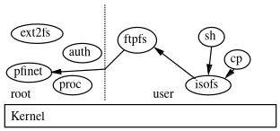
Hurd possibilities

Slide 19
Hurd possibilities
€ settrans -c ~/ftp: /hurd/hostmux /hurd/ftpfs /
(just once for good)
€ settrans -a ~/mnt /hurd/iso9660fs ~/ftp://ftp.gnu.org/old-gnu/gnu-f2/hurd-F2-main.iso
€ ls ~/mnt
README-or-FAIL
…
Only downloads what is needed.
Can be permanently stored in ext2fs
€ settrans ~/.signature /hurd/run /usr/games/fortune

Slide 20
Current state
Rather stable
  Have not reinstalled boxes for a decade
  Debian buildds keep building packages
~75% of Debian archive builds out of tree
  XFCE, gnome, KDE, …
Support merged upstream
  gcc, glibc, llvm, rust, ...
Debian distribution
Guix/Hurd released!

Slide 21
A roadmap?
Many many existing bits, just needs polishing
  The tail of “90% support done in 10% time, 10% support done in 90%time”
  But would be so cool to have really working!
Many ongoing project ideas
  Would welcome help
Many crazy ideas
  Would welcome experimenting

Slide 22
Bits to polish
httpfs/ftpfs
  cd /http://ftp.debian.org/debian/pool/main/h/hurd
  dpkg -iO *20181030-2*.deb
  cd /ftp://ftp.gnu.org/
  find . -name emacs\*

Slide 23
Bits to polish
Namespace-based translators
  cd software.tar.gz,,/
  cat README
  cd disk.img,,part1,,ext2fs/

Slide 24
Bits to polish
mboxfs
  cd mbox,,/
  mkdir that_man
  mv $(grep -l that@mail *) that_man

Slide 25
Bits to polish
Xmlfs
  cd index.html,,/
  cd html/body/
  for i in $(find . -name h1); do cat $i/.text ; done

Slide 26
Bits to polish
High-level language bindings for translators
  Perl (pith)
  Lisp
  Java
  Python

Slide 27
Bits to polish
Some more in hurdextras/
  jfs
  notice
  run
  unionfs

Slide 28
Hardware support
PAE on 32b
  Required for memory-hungry builds (webkit2gtk)
APIC, HPET (Damien Zammit)
  HPET required nowadays: software expects sub-tick time precision
ACPI (Damien Zammit)
  Running libacpica in userland, and tell kernel
PCI arbiter (Joan Lledó)
  Runs I/O port-accessing libpciaccess in userland

Slide 29
Hardware support (cont’)
USB disk/CD support (Damien Zammit)
  rumpusbdisk userland translator
  separate from rumpdisk (for SATA/IDE)
  integrates USB stack for now
  plans to split with ugen layer in between
Network devices support (Damien Zammit)
  rumpnet userland translator
  to replace the old netdde linux 2.6.32 translator
    (was based on unmaintained DDE)
Note: These assume maintenance of rump

Slide 30
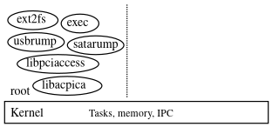
Hurd boot, userland disk
Really a library-based OS!

Slide 31
64b support
x86_64 support running well!
Kernel x86 boot (Luca Dariz)
mig RPCs (Flávio Cruz, Luca Dariz)
  Teach it 64 bitness, fix translations
  Then all RPCs work fine (“system calls” etc.)
gcc/gdb (Flávio Cruz)
  Mostly plumbing x86_64
hurd: 64 bitness fixes (Sergey Bugaev)
  also fixing future 64b archs

Slide 32
64b support (cont’)
bootstrap of Debian hurd-amd64
  Cross-buildability of software, essential!
  First ./configure-etc. shell scripts with --target/--host to fix early support (Flávio Cruz)
  Then Helmut Grohne’s rebootstrap script
    cross-builds all necessary packages for buildds
  Then unleash buildds!
Made it to debian’25
Preliminary work for arm64 (Sergey Bugaev)

Slide 33
SMP support
Mach originally had SMP support
  Kernel framework already there: locks, sched, ...
Initial code (Almudena Garcia): cpu detection, enumeration, cpus startup
Then a lot of fixes, and 64b (Damien Zammit)
Userland translators on CPU0 for now
  To avoid SMP-concurrency issues for now
  Will migrate to other cpus progressively
Other processes can go fine on other cpus

Slide 34
OS support
Security fixes (Sergey Bugaev)
  Tricks with ports, make sure not to leak access!
Memory fixes / stress tests (Michael Kelly)
  stress-ng really nice to trigger some bugs
pfinet TCP/IP stack still using linux 2.2 stack
  Costly to follow Linux’ net layer
being replaced by lwip as userland TCP/IP stack (Joan Lledó)

Slide 35
OS support (cont’d)
Translator records in /dev and /servers
  Used to be a Hurd-specific ext2 extensions
  Now using xattrs by default
  Can now cross-install completely from Linux
FS JBD2 journaling support (Milos Nikic)
  In progress
Console xkb keyboard layout (Etienne Brateau)

Slide 36
Quality
CI
gnumach: make check (Luca Dariz)
  Small userland programs to check kernel RPCs
  Really nice for progressive 64b port
  Now running as CI
debian salsa-gitlab pipelines
  gitlab runner thanks to gccgo port
exim and postgresql buildfarm animals
Ideally, integrate with as many upstreams as poss

Slide 37
Quality
Warnings (Diego Nieto Cid)
You want to avoid them
Permanent uphill battle with newer gcc versions
pthread-in-libc (Guy Fleury)
Was done by glibc on Linux
Thus nowadays software forgets -lpthread
Had to do it as well

Slide 38
Languages
rust
Ported through cross-build, but tedious
(thanks Vedant Tewari!)
  Has to teach it all ABI details
  bindgen didn’t help that much, had to review it all
  very moving target
    fast commit pace, release every 40 days
    and n+1 builds with ≥ n only!
  #cfg(target_os=”foo”) hell in a lot of crates
  two “errno” crates...
Now fully native build and up to date

Slide 39
Languages (cont’)
gccgo (Svante Signell)
Could just reuse a lot of BSD code
Some tweaking
Needed to fix split stack
Still not enough for quite a few packages
  Would need golang port, contribution welcome!

Slide 40
Languages (cont’ 2)
java openjdk
Previous work by Emilio Pozuelo Montfort
  Hurd support for siginfo, $ORIGIN, ...
Previous work by Jeremy Koenig
  Port openjdk6
We also have gcj from gcc-6
Damien Zammit taking on openjdk
  Tedious: n+1 builds with ≥ n... starting from openjdk7!

Slide 41
Dissemination
News coverage
Quarter of the Hurd (QotH) (Joshua Branson)
Guix/hurd (Manolis Ragkousis, Janneke Nieuwenhuizen, Yelninei)
https://guix.gnu.org/en/blog/2024/hurd-on-thinkpad/
Alpine (Sergey Bugaev)

Slide 42
So, what do we have?
x86_64, SMP
SATA/USB disks/cd, all in userland
network driver & TCP/IP all in userland
kernel only manages tasks, memory, IPC
go, rust, ocaml, ghc, some java, ...
Debian (~75% packages)
Guix
some Arch, some Alpine
And the usual Hurd stuff: user-controlled translators, fine-grain access control, sub-hurds, ...

Slide 43
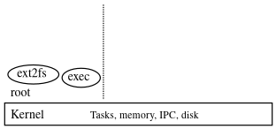
Hurd boot

Slide 44
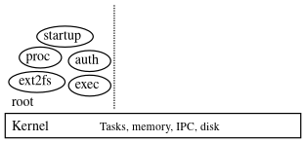
Hurd boot

Slide 45
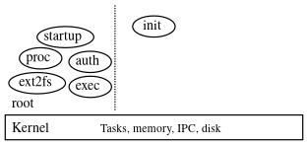
Hurd boot

Slide 46
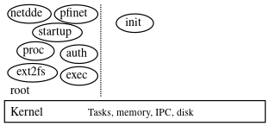
Hurd boot

Slide 47
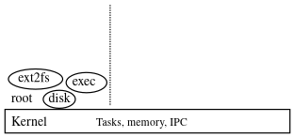
Hurd boot, userland disk

Slide 48
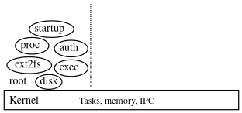
Hurd boot, userland disk

Slide 49
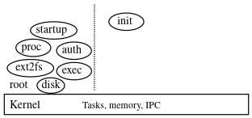
Hurd boot, userland disk

Slide 50
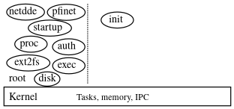
Hurd boot, userland disk

Slide 51
Example: interpose
TCP/IP stack
€ settrans -ca $HOME/servers/socket/2 /hurd/pfinet -i $HOME/servers/tun0
€ openvpn … $HOME/servers/tun0 &
€ remap /servers/socket/2 $HOME/servers/socket/2
€€€ wget www.gnu.org
My own translator
Can plug my own VPN software
Only wget accesses it (well, the shell too :) )

Slide 52
But also
€ remap /bin/sh $HOME/bin/sh
€ remap /bin $HOME/unionbin
…
Check out Stow/Nix/Guix!

Slide 53
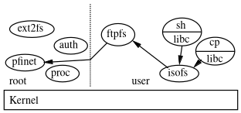
How does it work?

Slide 54
Rationale
- Everything is an (interposable) RPC
- Translators exposed in the FS
The user gets to decide what/how to interpose
  Without need for costly ptrace or fragile libc symbols interposition.
  Native fakeroot/chroot
  Fully virtualized and fine-grained interface
Just need to use what's provided by the admin, e.g.
  $HOME/
  TCP/IP stack
and pile over it

Slide 55
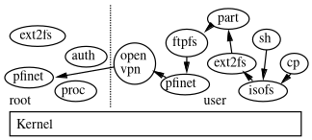
Hurd possibilities (cont'ed)

Slide 56
Hurd possibilities (cont'ed)
i.e. ISO image inside a partitioned disk image
on ftp over a VPN

Slide 57
Hurd possibilities (cont'ed)
eth0
i.e. ISO image inside a partitioned disk image
on ftp over a VPN

Slide 58
Hurd possibilities (cont'ed)
VPN running as user
Parted running as user
Chroot running as user
Tarfs, Xmlfs, cvsfs, httpfs, gopherfs, ...
...
No less power than root
  Since root uses the same mechanism anyway!
  Except direct hardware access, of course
    And still, can chmod o+rw /dev/eth0
    And still, could be interfaced safely thanks to I/O MMU
More power for everybody (root and non-root)
  Combine translators, invent new ones without kernel programming, ...

Slide 59
Hurd possibilities (cont'ed)
No less power than root
  Since root uses the same mechanism anyway!
  Except direct hardware access, of course
    And still, can chmod o+rw /dev/eth0
    And still, could be interfaced safely thanks to I/O MMU
More power for everybody (root and non-root)
  Combine translators, invent new ones without kernel programming, ...

Slide 60
So, FUSE vs Hurd?
FUSE is here
  At last!
  Not available by default on Linux installations
  Does not permit everything to users
  Also CUSE, UIO, uinput … as many partial solutions
Hurd is here too
  At last!
  Provides everything by default
    Including ioctls, arbitrary RPCs actually, could have a node which is a file, AND a directory, AND a CD drive,...
    SCSI over ssh? Sure! And as non-root!
  Permits everything to users
    Hardware access is controlled

Slide 61
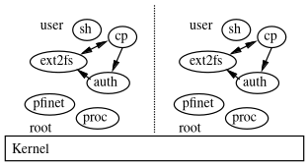
Neighbour Hurds

Slide 62
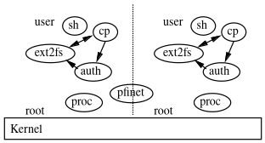
Neighbour Hurds, shared pfinet

Slide 63
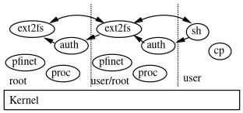
Sub-Hurd

Slide 64
Neighbour/Sub-Hurd
Looks like Linux containers
Except they can be combined in many ways, including recursive
  Simply the standard features in the Hurd
  Safer, because ext2fs, pfinet, etc. are not shared
And complete
  Since that's how a normal Hurd system is structured already.
    Linux containers have a hard time being completely contained, e.g. sound?

Slide 65
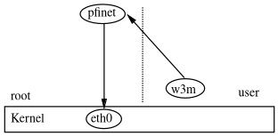
Hurd userland network support
/servers/socket/2

Slide 66
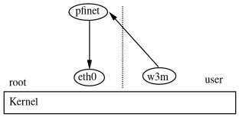
Hurd userland network support
DDE layer
Linux drivers
/dev/eth0

Slide 67
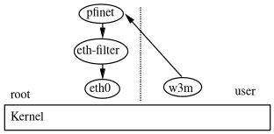
Hurd userland network support

Slide 68
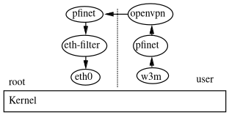
Hurd userland network support
/servers/socket/2
~/servers/tun0
~/servers/socket/2

Slide 69
Accessing PCI cards
Eth0 network drivers (netdde) access PCI config space at bootup
Xorg too
Rump sound drivers too
…
But that’s not concurrent-access-safe :)

Slide 70
Accessing PCI cards
Translator for concurrent access to PCI config
Sitting on /servers/pci/<dom>/<bus>/<dev>/<fn>
Provides pci_conf_read/write, get_dev_regions, get_dev_rom
Enough to implement libpciaccess & pciutils backends

Slide 71
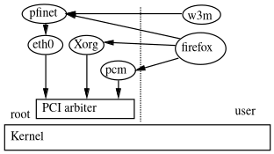
Accessing PCI cards

Slide 72
Accessing PCI cards as user
While at it, let’s allow Unix user permission configuration
Give PCI card access on the fly with
  fsysopts /servers/pci --uid 1234 --p 00:1f.3
  (or configure it permanently with settrans)
User app can then
  Read/write config
  TODO: map resources / ROM
  TODO: get i/o port access token

Slide 73
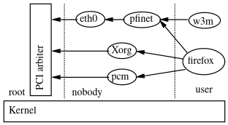
Accessing PCI cards as user

Slide 74
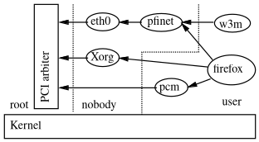
Accessing PCI cards as user

Slide 75
Accessing PCI cards as user
Woah, give a PCI card to a user?!
DMA access to the whole memory!
But IO-MMU can control that
Just like PCI passthrough with hypervisors
And some cards provide various functions
Give only one access to the card

Slide 76
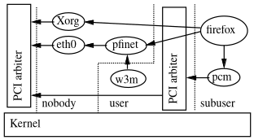
Accessing PCI cards as user

Slide 77
Hurd userland network support
€ settrans -ca ~/servers/socket/2 \
~/bin/pfinet -i ~/servers/tun0 \
-a 80.67.176.254 -p 80.67.179.1
€ vpn.sh ~/servers/tun0 &
€ ~/bin/remap \
/servers/socket/2 ~/servers/socket/2 \
/etc/resolv.conf ~/resolv.conf
€€€ wget www.gnu.org
My own translators
Only wget accesses my pfinet (well, the shell too :) )

Slide 78
DDE stack
Based on TU-Dresden's DDE stack
Zheng Da's GSOC
Ported to Mach kernel
Ported to Mach device interface
Updated libdde_linux26 for long-term-supported linux 2.6.32
  Most drivers (and mostly the really useful ones) just work without patches
Used by default by Debian GNU/Hurd

Slide 79
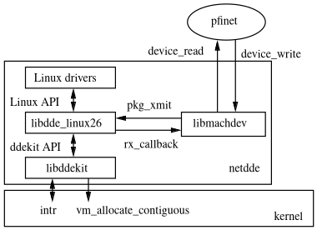
DDE stack

Slide 80
DDE stack
Only two additions to the kernel
  Interrupt delivery and masking
  Physically-contiguous memory allocation
  (Direct I/O access was already available)
Performance similar to in-kernel driver
Driver in a separate process
  Can just crash and be happy with it...
  Can easily debug and profile them
  Stack smashing protection ;)
  Could benefit from I/O MMU for better isolation.
    For now drivers can just access all RAM...

Slide 81
DDE stack Interrupt delivery
Edge-triggered IRQ
  A mere message
Level-triggered IRQ
  Have to keep hardware IRQ masked
  Until userland driver reenables it
    Not nice for sharing IRQ with other drivers...
Pb: most Linux drivers do not set SA_INTERRUPT
  i.e. IRQ supposed to be kept masked
  → Level-triggered IRQ actually...

Slide 82
More DDE?
Disk DDE is supposed to be working
  Should be not very complex
    device_read / device_write
  Zheng Da said he didn't manage to make it work
USB/sound DDE was mentioned as experimental
  I don't know the status?
  We would definitely love to have that
Rather use Rump kernels?

Slide 83
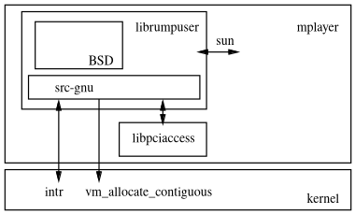
Rump sound support, v0

Slide 84
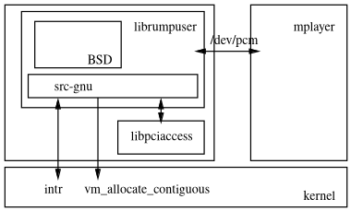
Rump sound support, v1

Slide 85
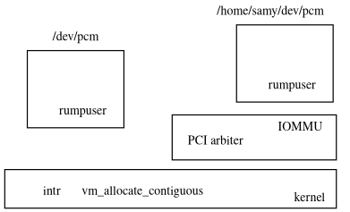
Rump sound support, v2

Slide 86
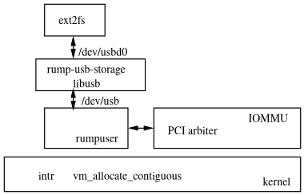
Rump USB support

Slide 87
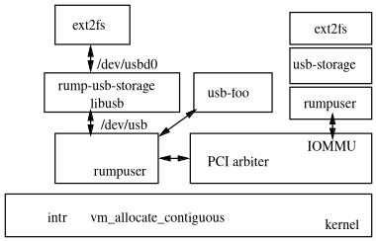
Rump USB support

Slide 88
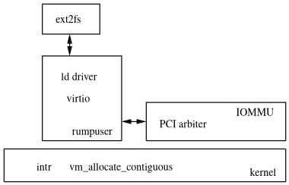
Rump virtio disk support

Slide 89
Hurd userland console support
Modular design similar to screen
Server running virtual ttys and gettys on them
Client with drivers
  Keyboard + mouse + VGA,
  or ncurses,
  or whatever

Slide 90
Hurd userland console support
Keyboard driver
Gets keyboard/mouse events from kernel
Translation done through xkb
  No need to maintain our own keymaps any more

Slide 91
Hurd userland console support
VGA driver
Directly drives VGA board in VGA text mode
256/512 dynamic glyphs support
  32-126 static ASCII characters for compatibility
  Other glyphs dynamically allocated from BFD font
  GNU greets user!
Double-width glyph support
  Can print kanjis in text mode!

Slide 92
Nice translators
Tarfs, cvsfs, xmlfs, mboxfs
Https, ftpfs, gopherfs
Libfuse
Run
  Dynamic ~/.signature :)
Netio/socketio (~= bash's /dev/tcp)
  cat ~/servers/socketio/tcp/ftp.gnu.org/21
Nsmux
  find foo.html,,xmlfs/body/ -name \*foo\*
Unionmount

Slide 93
Real-life ext2fs/e2fsck debugging
Some ext2fs volume got corrupted
ext2fs translator keeping crashing on opening it
  A matter of gdb on ext2fs
  Actually bogus inode number in the (hurd-only) translator record
  e2fsck should have been able to clean that!
Add i_translator check to e2fsck
Remount with ext2fs, now fine

Slide 94
Real-life ext2fs/e2fsck debugging
No actual system crash & reboot
Mere gdb run and debunk
Could even have been done as a user
  (would have had to have access to the disk)

Slide 95
Normal file path
ext2fs

Slide 96
ext2fs example
Bug report: “UTIME_NOW/OMIT are not defined” (for wine)
int fd;
struct timespec times[2];
fd = open (“foo.txt”, O_WRONLY);
times[0].tv_sec = time(NULL);
times[0].tv_nsec = 42424242;
times[1].tv_nsec = UTIME_OMIT;
futimens (fd, ts);

Slide 97
ext2fs example
RPC principle
Open a connection
Run RPCs over it
Close the connection
Here,
fd = open(“foo.txt”);
futimens(fd);
close(fd);

Slide 98
ext2fs example
Opening the connection
foo.txt is a normal file
  € showtrans foo.txt
foo.txt is in the current directory
The current directory is served by ext2fs:
  € fsysopts .
  ext2fs device:sd1
So open(“foo.txt”) actually connects to ext2fs

Slide 99
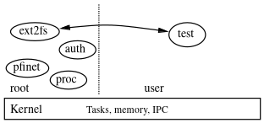
ext2fs example

Slide 100
ext2fs example
RPC being run
See futimens() source code in glibc
  /usr/src/glibc€ find . -name futimens.c
  ./io/futimens.c
  ./sysdeps/mach/hurd/futimens.c ← that's it!
  ./sysdeps/unix/sysv/linux/futimens.c
Basically just does
  __file_utimes (port, atime, mtime);
port is the low-level RPC port behind fd
This is an RPC! Let's now look for the server side

Slide 101
ext2fs example
/usr/src/hurd€ rgrep file_utimes .
./hurd/fs.defs:routine file_utimes (
…
./libdiskfs/file-utimes.c:diskfs_S_file_utimes (struct protid...
./libtreefs/s-file.c:treefs_S_file_utimes (struct treefs_protid...
./libtrivfs/file-utimes.c:trivfs_S_file_utimes (struct trivfs_protid...
but no ext2fs?!
/usr/src/hurd€ ldd /hurd/ext2fs
libdiskfs.so.0.3 => /lib/i386-gnu/libdiskfs.so.0.3 (0x01086000)
→ it's libdiskfs/file-utimes.c

Slide 102
ext2fs example
diskfs_S_file_utimes (... cred, ... atime, ... mtime) {
…
if (atime.microseconds == -1)
…
else {
np->dn_stat.st_atim.tv_sec = atime.seconds;
…
}
...
So it's -1!

Slide 103
ext2fs example
Exercice for the audience
Add #defines for UTIME_NOW and UTIME_OMIT to glibc/sysdeps/mach/hurd/bits/stat.h, see glibc/sysdeps/unix/sysv/linux/bits/stat.h for an example
Add code to ./sysdeps/mach/hurd/futimens.c to handle the UTIME_NOW case.
Add code to ./sysdeps/mach/hurd/futimens.c to put -1 in structure for the RPC in the UTIME_OMIT case.
Test, enjoy, polish, submit!

Slide 104
socket path
pflocal

Slide 105
pflocal example
Bug report: “setsockopt(SO_SNDBUF) returns ENOPROTOOPT on PF_LOCAL sockets” (for globus-gram-job-manager)
int f;
int size = 1024;
f = socket (PF_LOCAL, SOCK_STREAM, 0);
if (setsockopt (f, SOL_SOCKET, SO_SNDBUF, &size, sizeof (size)) < 0)
perror ("setsockopt");

Slide 106
pflocal example
RPC principle
Open a connection
Run RPCs over it
Close the connection
Here,
fd = socket(PF_LOCAL);
setsockopt(fd, SOL_SOCKET, SO_SNDBUF);
close(fd);

Slide 107
pflocal example
What server will that be?
ext2fs case was easy: file name, showtrans / fsysopts.
socket case more involved
socket()'s source code:
  /usr/src/glibc€ find . -name socket.c
  ./socket/socket.c
  ./sysdeps/mach/hurd/socket.c

Slide 108
pflocal example
__socket (domain, type, protocol) {
socket_t sock, server;
server = _hurd_socket_server (domain, 0);
__socket_create (server, type, protocol, &sock);
return _hurd_intern_fd (sock, …);
}
socket_t is a typedef for the port type, so:
get a port to a server
RPC on it to get a port
that will be the socket

Slide 109
pflocal example
hurd_socket_server (int domain, int dead) {
… /* Code which basically does: */
char name[sizeof (_SERVERS_SOCKET) + 100];
sprintf (name, “%s/%d”, _SERVERS_SOCKET, domain);
server = __file_name_lookup (name, 0, 0);
return server;
}
_SERVERS_SOCKET is #defined to “/servers/socket”
__file_name_lookup is what open() calls
domain is PF_LOCAL, which is #defined to 1
→ it's merely opening /servers/socket/1

Slide 110
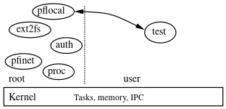
pflocal example
€ showtrans /servers/socket/1
/hurd/pflocal
→ it's translated by pflocal!

Slide 111
pflocal example
RPC being run
/usr/src/glibc€ find . -name setsockopt.c
./socket/setsockopt.c
./sysdeps/mach/hurd/setsockopt.c
basically calls __socket_setopt on the port, i.e. an RPC
/usr/src/hurd€ grep -r socket_setopt .
./hurd/socket.defs:routine socket_setopt (
./pflocal/socket.c:S_socket_setopt (struct sock_user …
./pfinet/socket-ops.c:S_socket_setopt (struct sock_user …

Slide 112
pflocal example
S_socket_setopt (user, level, opt, value, value_len) {
…
switch (level)
{
default:
ret = ENOPROTOOPT;
break;
}
…
}

Slide 113
pflocal example
Exercice for the audience
Add SOL_SOCKET and SO_SNDBUF cases in S_socket_setopt
Notice that pflocal actually just uses libpipe for its buffering
Find the “write_limit” buffer size in libpipes
Implement there dynamically changing it
Plug that into S_socket_set/getopt()
Test, enjoy, polish, submit!

Slide 114
Memory management
gnumach

Slide 115
gnumach example
Bug report: “mlock() as non-root always returns EPERM” (for gnome-keyring)
char s[128];
if (mlock (&s, sizeof(s)) < 0)
perror ("mlock");
/usr/src/glibc€ find . -name mlock.c
./misc/mlock.c
./sysdeps/mach/hurd/mlock.c

Slide 116
gnumach example
mlock (address, len) {
mach_port_t hostpriv;
__get_privileged_ports (&hostpriv, NULL);
…
__vm_wire (hostpriv, __mach_task_self(), page, len, VM_PROT_READ);
…
}
__get_privileged_ports returns a port
we make an RPC on it.
Hurd hackers know hostpriv is usually gnumach, but let's see how!

Slide 117
gnumach example
__get_privileged_ports (host_priv_ptr, device_master_ptr) {
…
__USEPORT (PROC, __proc_getprivports (port, &_hurd_host_priv, &_hurd_device_master));
…
*host_priv_ptr = _hurd_host_priv;
…
}

Slide 118
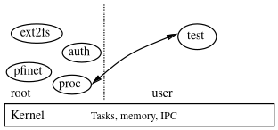
gnumach example
So we're actually first talking with the proc server
Because gnumach knows nothing about uids!
proc knows whether process is uid 0 and thus allowed to access the gnumach privileged port

Slide 119
gnumach example
/usr/src/hurd€ rgrep proc_getprivports
hurd/process.defs:routine proc_getprivports (
proc/host.c:S_proc_getprivports (struct proc *p,
S_proc_getprivports (p, hostpriv, devpriv) {
if (! check_uid (p, 0))
return EPERM;
*hostpriv = _hurd_host_priv;
*devpriv = _hurd_device_master;
return 0;
}

Slide 120
gnumach example
proc
started at system bootstrap
passed the privileged port at that time
checks uid
Why doing that way?
Consider a sub-hurd
  Control whether processes there can mlock()

Slide 121
gnumach example
Ok, so it's a gnumach RPC
/usr/src/gnumach€ rgrep vm_wire
./include/mach/mach_host.defs:routine vm_wire(
./vm/vm_user.c:kern_return_t vm_wire(host, map, start, size, …
vm_wire (host, map, start, size, access) {
if (host == HOST_NULL)
return KERN_INVALID_HOST;
…
return vm_map_pageable_user (...);
}

Slide 122
gnumach example
So, what do we need to do?
gnumach controls whether allowed or not.
Don't want to let all processes mlock() a lot of memory
ulimit -l, i.e. setrlimit (RLIMIT_MEMLOCK) controls how much is allowed for non-root, 64K by default
Ideally, plug glibc's setrlimit() with gnumach
As a first step, default to 64K

Slide 123
gnumach example
Exercise for the audience
Add per-task vm_wire() counter to gnumach
Allow tasks passing host == NULL to vm_wire() as much as 64K
Patch setrlimit to advertise 64K as being fixed (for now).
Test, enjoy, polish, submit!

Slide 124
State, news, future, etc.

Slide 125
Porting packages to hurd-i386
This is essentially a POSIX system
  So portable portable programs should just work fine
Top dumb issues
  Not linux or BSD? #include <windows.h>
  #if !defined(foobsd) && !defined(aix) && !defined(foobar)…
  #include <sys/prctl.h> #endif
  Have mach.h? Must be MacOS
  make -j $(grep … /proc/cpuinfo) → make -j
  #include <linux/limits.h>
  hardcoded errno values
  Missing -lpthread, -ldl, -lX11, ...
See Hurd porter page's developer corner
And PATH_MAX not defined, as allowed by POSIX...

Slide 126
PATH_MAX is evil for you
Fragile semantic in POSIX
Never meant to mean “reasonable size for a buffer containing a file name”
  Linux' 4096 : a whole page, a whole TLB entry !
Paths can actually be longer
  “hidden”, ”protected” files?!
Does that include the trailing \0? (not so clear in POSIX...)
  Does your code actually properly handle that?
A can of worms that nobody really tests...

Slide 127
Current State
Hardware support
i686
start of 64bit support
  Kernel boots completely, now missing RPC 32/64bit translation
DDE Linux 2.6.32 drivers layer for network boards
  In userland netdde translator!
IDE, Xorg, …
AHCI driver for SATA
Xen PV domU
  Required GNU Mach changes only
Preliminary sound support through userland Rump
No USB yet

Slide 128
Current State
Software support
Quite stable
  Have not reinstalled boxes for a decade.
  Debian buildds keep building packages, no hang after weeks!
~80% of Debian archive builds out of tree
  XFCE, almost gnome, almost KDE
  Firefox (aka iceweasel), gnumeric, …
Standard native Debian Installer

Slide 129
Recent work
GNU Guix and GuixSD
  A pure GNUish GNU/Hurd distro!
  Proper bootstrap of the Hurd chain
    Used by Debian GNU/Hurd rebootstrap effort
  A bit more work to be bootable
Using xattr for storing translator records
Various optimizations and stabilization
  Protected payloads
  Paging management
  Message dispatch
  Gsync ~= futex, used in glibc & libpthread

Slide 130
Recent work (2)
Highmem support (>4GB mem)
Unprivileged subhurds
  Think of containers, but safe to run by users,
  by construction
LwIP TCP/IP stack
Distributed system (netmsg)

Slide 131
Releases
Nice 0.401 release on April 2011.
Arch Hurd LiveCD release on August 2011.
Hurd 0.9, Mach 1.8, MIG 1.8
Released Debian-unofficial
  wheezy/sid snapshot CDs on May 2013 \o/
  jessie/sid snapshot CDs on May 2015 \o/
  stretch/sid snapshot CDs on June 2017 \o/

Slide 132
Removal from ftp-master
Due since many years
Not really useful to mirror all over the world anyway
But beware of consequences
  buildd.debian.org able to get fed from debian-ports?
    Scheduled binNMUs for transitions
    Losing this would be very tedious for ports maintainers
    Exposure in e.g. http://buildd.debian.org/yourpackage
  Toolchain version upgrades (gcc, perl)
    Give $WHOEVER_DOES_IT accounts just to be able to check those?
In short, managing to get most support without extra load?
Conversely, those would help ports currently on debian-ports
Real status for Second-Class Citizens
  BoF?

Slide 133
Future work
{sound,usb,disk,net} Rump drivers
x86_64 support
Read-ahead
Startup in scheme?
Your own pet project?

Slide 134
Hardware support
Æternam issue of all our nice micro-kernel projects
KVM / Xen support
  Leverage existing system
  Not satisfactory, even if very good performance: users want to run on real hardware of course!
DDE layer
  Leverage Linux drivers
  Still has to be maintained
  Shared maintenance?

Slide 135
People at work nowadays
Emilio Pozuelo Monfort : gnome
Jeremie Koenig : glibc, openjdk
Olaf Buddenhagen : community, mentor
Pino Toscano : KDE
Samuel Thibault : debian installer, autobuilders
Thomas Schwinge : GNU gdb, gcc
And various porters : Gabriele Giacone, Svante Signell, …
You're welcome!

Slide 136
Conclusion
x86_64, SMP
SATA/USB disks/cd, all in userland
network driver & TCP/IP all in userland
kernel only manages tasks, memory, IPC
go, rust, ocaml, ghc, some java, ...
A lot of nice things to achieve in GNU/Hurd
  https://www.gnu.org/software/hurd/contributing.html
GNU/Hurd is almost there with Debian/Guix/Arch/Alpine
    Just needs your help :)

Slide 137
Thanks!
For listening
And to the people working on all this
http://hurd.gnu.org/
http://www.debian.org/ports/hurd/
The increasing irrelevance of IPC performance for microkernel-based Operating Systems
  http://citeseerx.ist.psu.edu/viewdoc/download?doi=10.1.1.37.9653&rep=rep1&type=pdf

